Slide 1

Azul Connect

Slide 2
Project Vision
Connect creative individuals with groups that can enact dreams
Allow innovation by promoting the public view of project ideas
Provide an opportunity for the community to engage & improve with applied experience on projects

Slide 3
Problem
Lack of Ideas: Many ideas are never shared, and can never improve the community
Lack of Connections: Many ideas that are present lack widespread advertising, and don’t reach all interested people
Talent & Ability: No one person can accomplish all projects on their own, limiting the scope of ideas
Freedom: The more common University-sponsored projects have relatively rigid requirements, which can prevent creative solutions

Slide 4

Product Overview

Slide 5
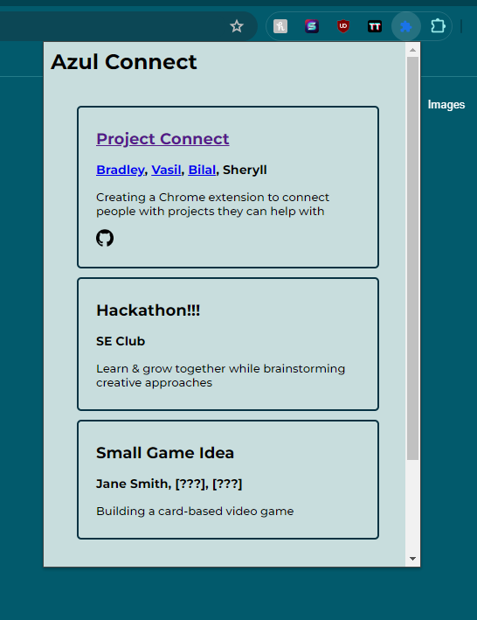
Key Features
Open Forum: All members are encouraged to share their project ideas
Ease-of-Use: Extension has a simple interface with a clean and easy-to-use design
Access to Resources: The main contributors already on the project and links to project resources are present
Messaging: (TBD) Allows prospective project participants to connect with project members before joining

Slide 6
Technologies
HTML/CSS-based extension
Document-style database (e.g. MongoDB)
Linked internal/external platform for communication
That’s all! Lightweight = Easier to implement

Slide 7

Moving On
Figma: Stylized Prototype

